Slide 1

Algorithms and Data Structures 2 CS 1501
Fall 2021
Sherif Khattab
ksm73@pitt.edu
(Slides are adapted from Dr. Ramirez’s and Dr. Farnan’s CS1501 slides.)

Slide 2
Announcements
Upcoming deadlines:
4/21: Assignment 4
4/21: Homework 12
4/23: Lab 11
4/30: Lab 12
5/2: Assignment 5
5/2: Bonus Homework
Extra Lecture Videos on dynamic programming and approximation algorithms
Tophat questions are due one week after each lecture
OMETs
1 bonus point for entire class when response rate >= 80%
Currently at ~48%
Deadline is Sunday 4/25

Slide 3
Last lecture …
(Big)Integer Algorithms
RSA encryption

Slide 4
Muddiest points
RSA Example
Phi(n)
Reduction and RSA attacks

Slide 5
This Lecture
(Big)Integer Algorithms
RSA encryption
Dynamic Programming

Slide 6
Consider the change making problem
What is the minimum number of coins needed to make up a given value k?
If you were working as a cashier, what would your algorithm be to solve this problem?

Slide 7
This is a greedy algorithm
At each step, the algorithm makes the choice that seems to be best at the moment
Have we seen greedy algorithms already this term?
Yes!
Building Huffman trees
Nearest neighbor approach to travelling salesman

Slide 8
… But wait …
Nearest neighbor doesn't solve travelling salesman
Does not produce an optimal result
Does our change making algorithm solve the change making problem?
For US currency…
But what about a currency composed of pennies (1 cent), thrickels (3 cents), and fourters (4 cents)?
What denominations would it pick for k=6?

Slide 9
So what changed about the problem?
For greedy algorithms to produce optimal results, problems must have two properties:
Optimal substructure
Optimal solution to a subproblem leads to an optimal solution to the overall problem
The greedy choice property
Globally optimal solutions can be assembled from locally optimal choices
Why is optimal substructure not enough?
Notes:
Opt. substructure:
If we know the best way to make 3 cents, we can use that to find the best way to make 6 cents
Greedy choice:
When looking to make 6 cents, we know for US currency that the best overall choice will be to use the biggest coin (nickel)
With thrickels/fourters, we can't know until we've looked at all possible breakdowns
Note that this can be done recursively

Slide 10
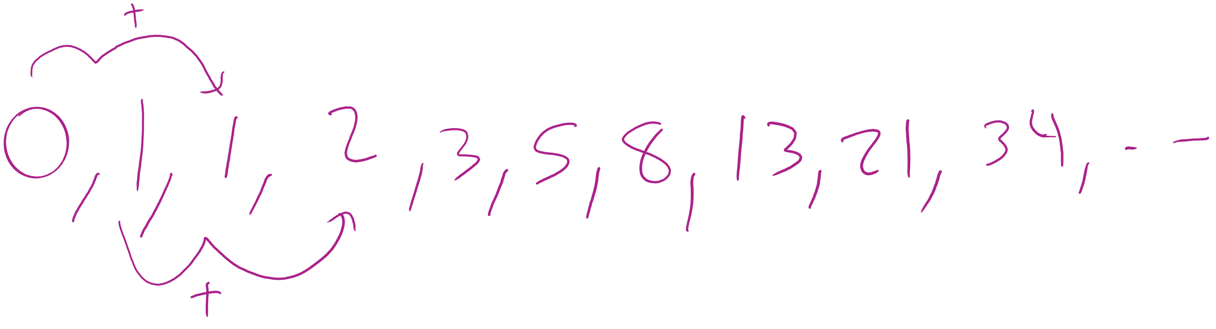
Finding all subproblems solutions can be inefficient
Consider computing the Fibonacci sequence:
int fib(n) { if (n == 0) { return 0 }; else if (n == 1) { return 1 }; else { return fib(n - 1) + fib(n - 2); } }
What does the call tree for n = 5 look like?

Slide 11
fib(5)
fib(5)
fib(4)
fib(3)
fib(4)
fib(3)
fib(3)
fib(3)
fib(2)
fib(2)
fib(2)
fib(1)
fib(2)
fib(1)
fib(2)
fib(2)
fib(1)
fib(1)
fib(1)
fib(1)
fib(0)
fib(0)
fib(1)
fib(0)
fib(1)
fib(0)
fib(1)
fib(1)
fib(0)
fib(0)
Notes:
How many times is fib(1) called?
What about n = 6?

Slide 12
How do we improve?
fib(5)
fib(4)
fib(3)
fib(3)
fib(2)
fib(2)
fib(1)
fib(2)
fib(1)
fib(1)
fib(0)
fib(1)
fib(0)
fib(1)
fib(0)
Notes:
Reuse generated results just like we did with Karatsuba's

Slide 13
Memoization
int[] F = new int[n+1]; F[0] = 0; F[1] = 1; for(int i = 2; i <= n; i++) { F[i] = -1 };
int dp_fib(x) { if (F[x] == -1) { F[x] = dp_fib(x-1) + dp_fib(x-2); } return F[x]; }

Slide 14
Note that we can also do this bottom-up
int bottomup_fib(n) {
if (n == 0)
return 0;
int[] F = new int[n+1];
F[0] = 0;
F[1] = 1;
for(int i = 2; i <= n; i++) {
F[i] = F[i-1] + F[i-2];
}
return F[n];
}
Notes:
THIS IS DYNAMIC PROGRAMMING

Slide 15
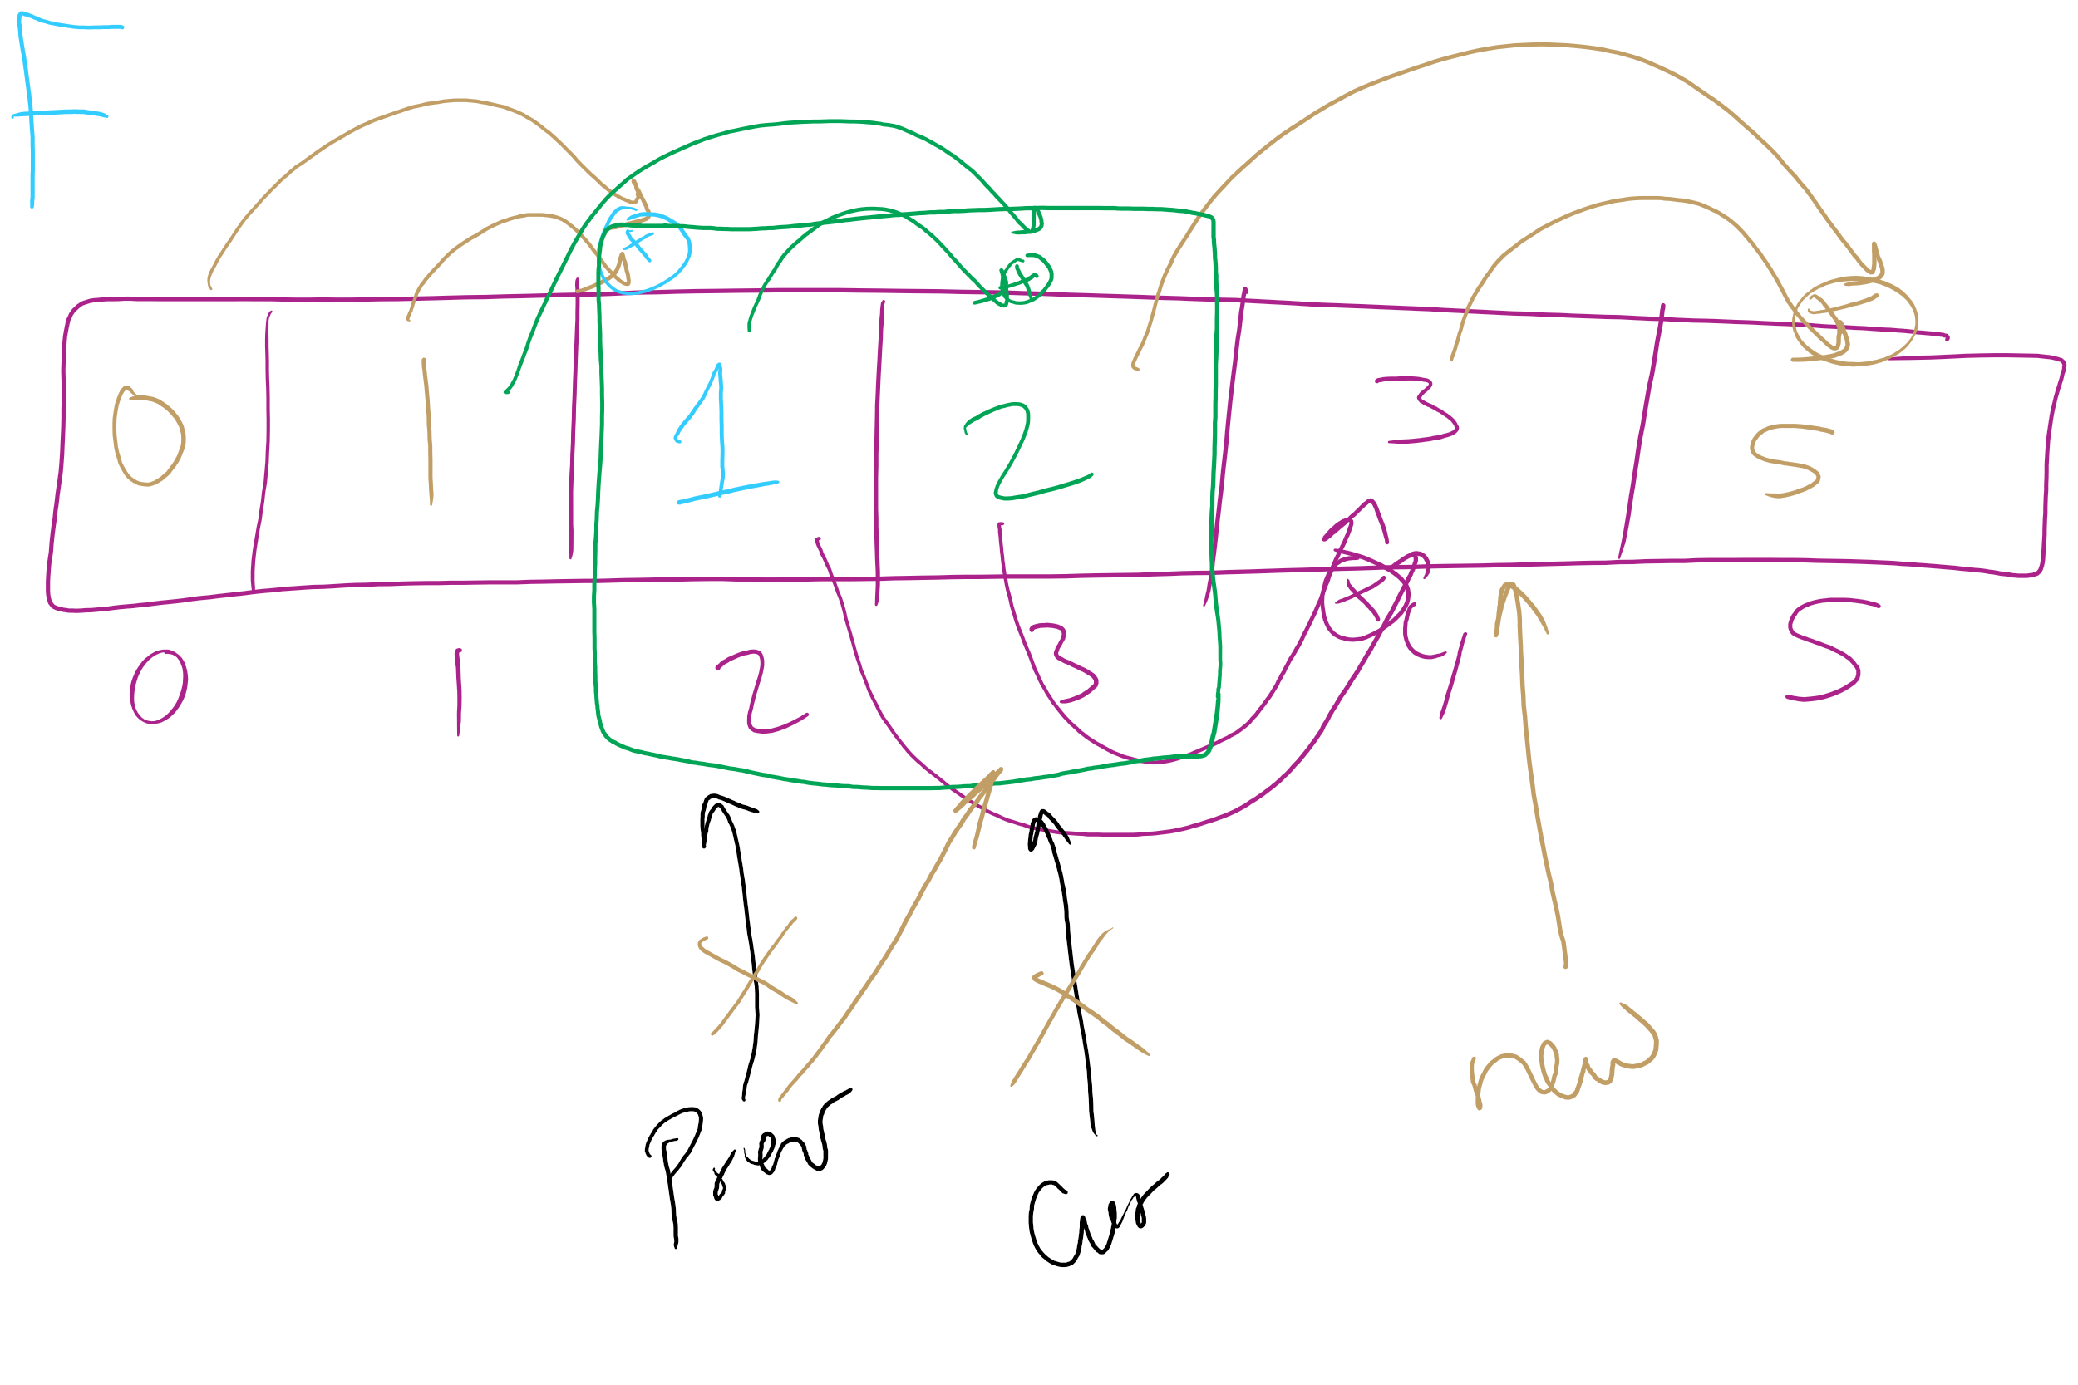
Can we improve this bottom-up approach?
int improve_bottomup_fib(n) {
int prev = 0;
int cur = 1;
int new;
for (int i = 0; i < n; i++) {
new = prev + cur;
prev = cur;
cur = new;
}
return cur;
}

Slide 16
Where can we apply dynamic programming?
To problems with two properties:
Optimal substructure
Optimal solution to a subproblem leads to an optimal solution to the overall problem
Overlapping subproblems
Naively, we would need to recompute the same subproblem multiple times
Notes:
Note that both problems amenable to DP and those amenable to greedy exhibit optimal substructure, the difference is if the greedy choice property exists or if overlapping subproblems

Slide 17
The unbounded knapsack problem
Given a knapsack that can hold a weight limit L, and a set of n types items that each has a weight (w_{i}) and value (v_{i}), what is the maximum value we can fit in the knapsack if we assume we have unbounded copies of each item?
Notes:
Start off asking how to solve problem (greedy or dp?)
Does it exhibit optimal substructure?
Does it exhibit greedy choice property?
Does it exhibit overlapping subproblems?

Slide 18
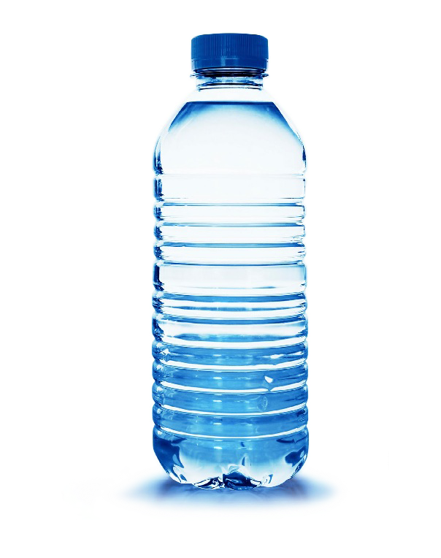
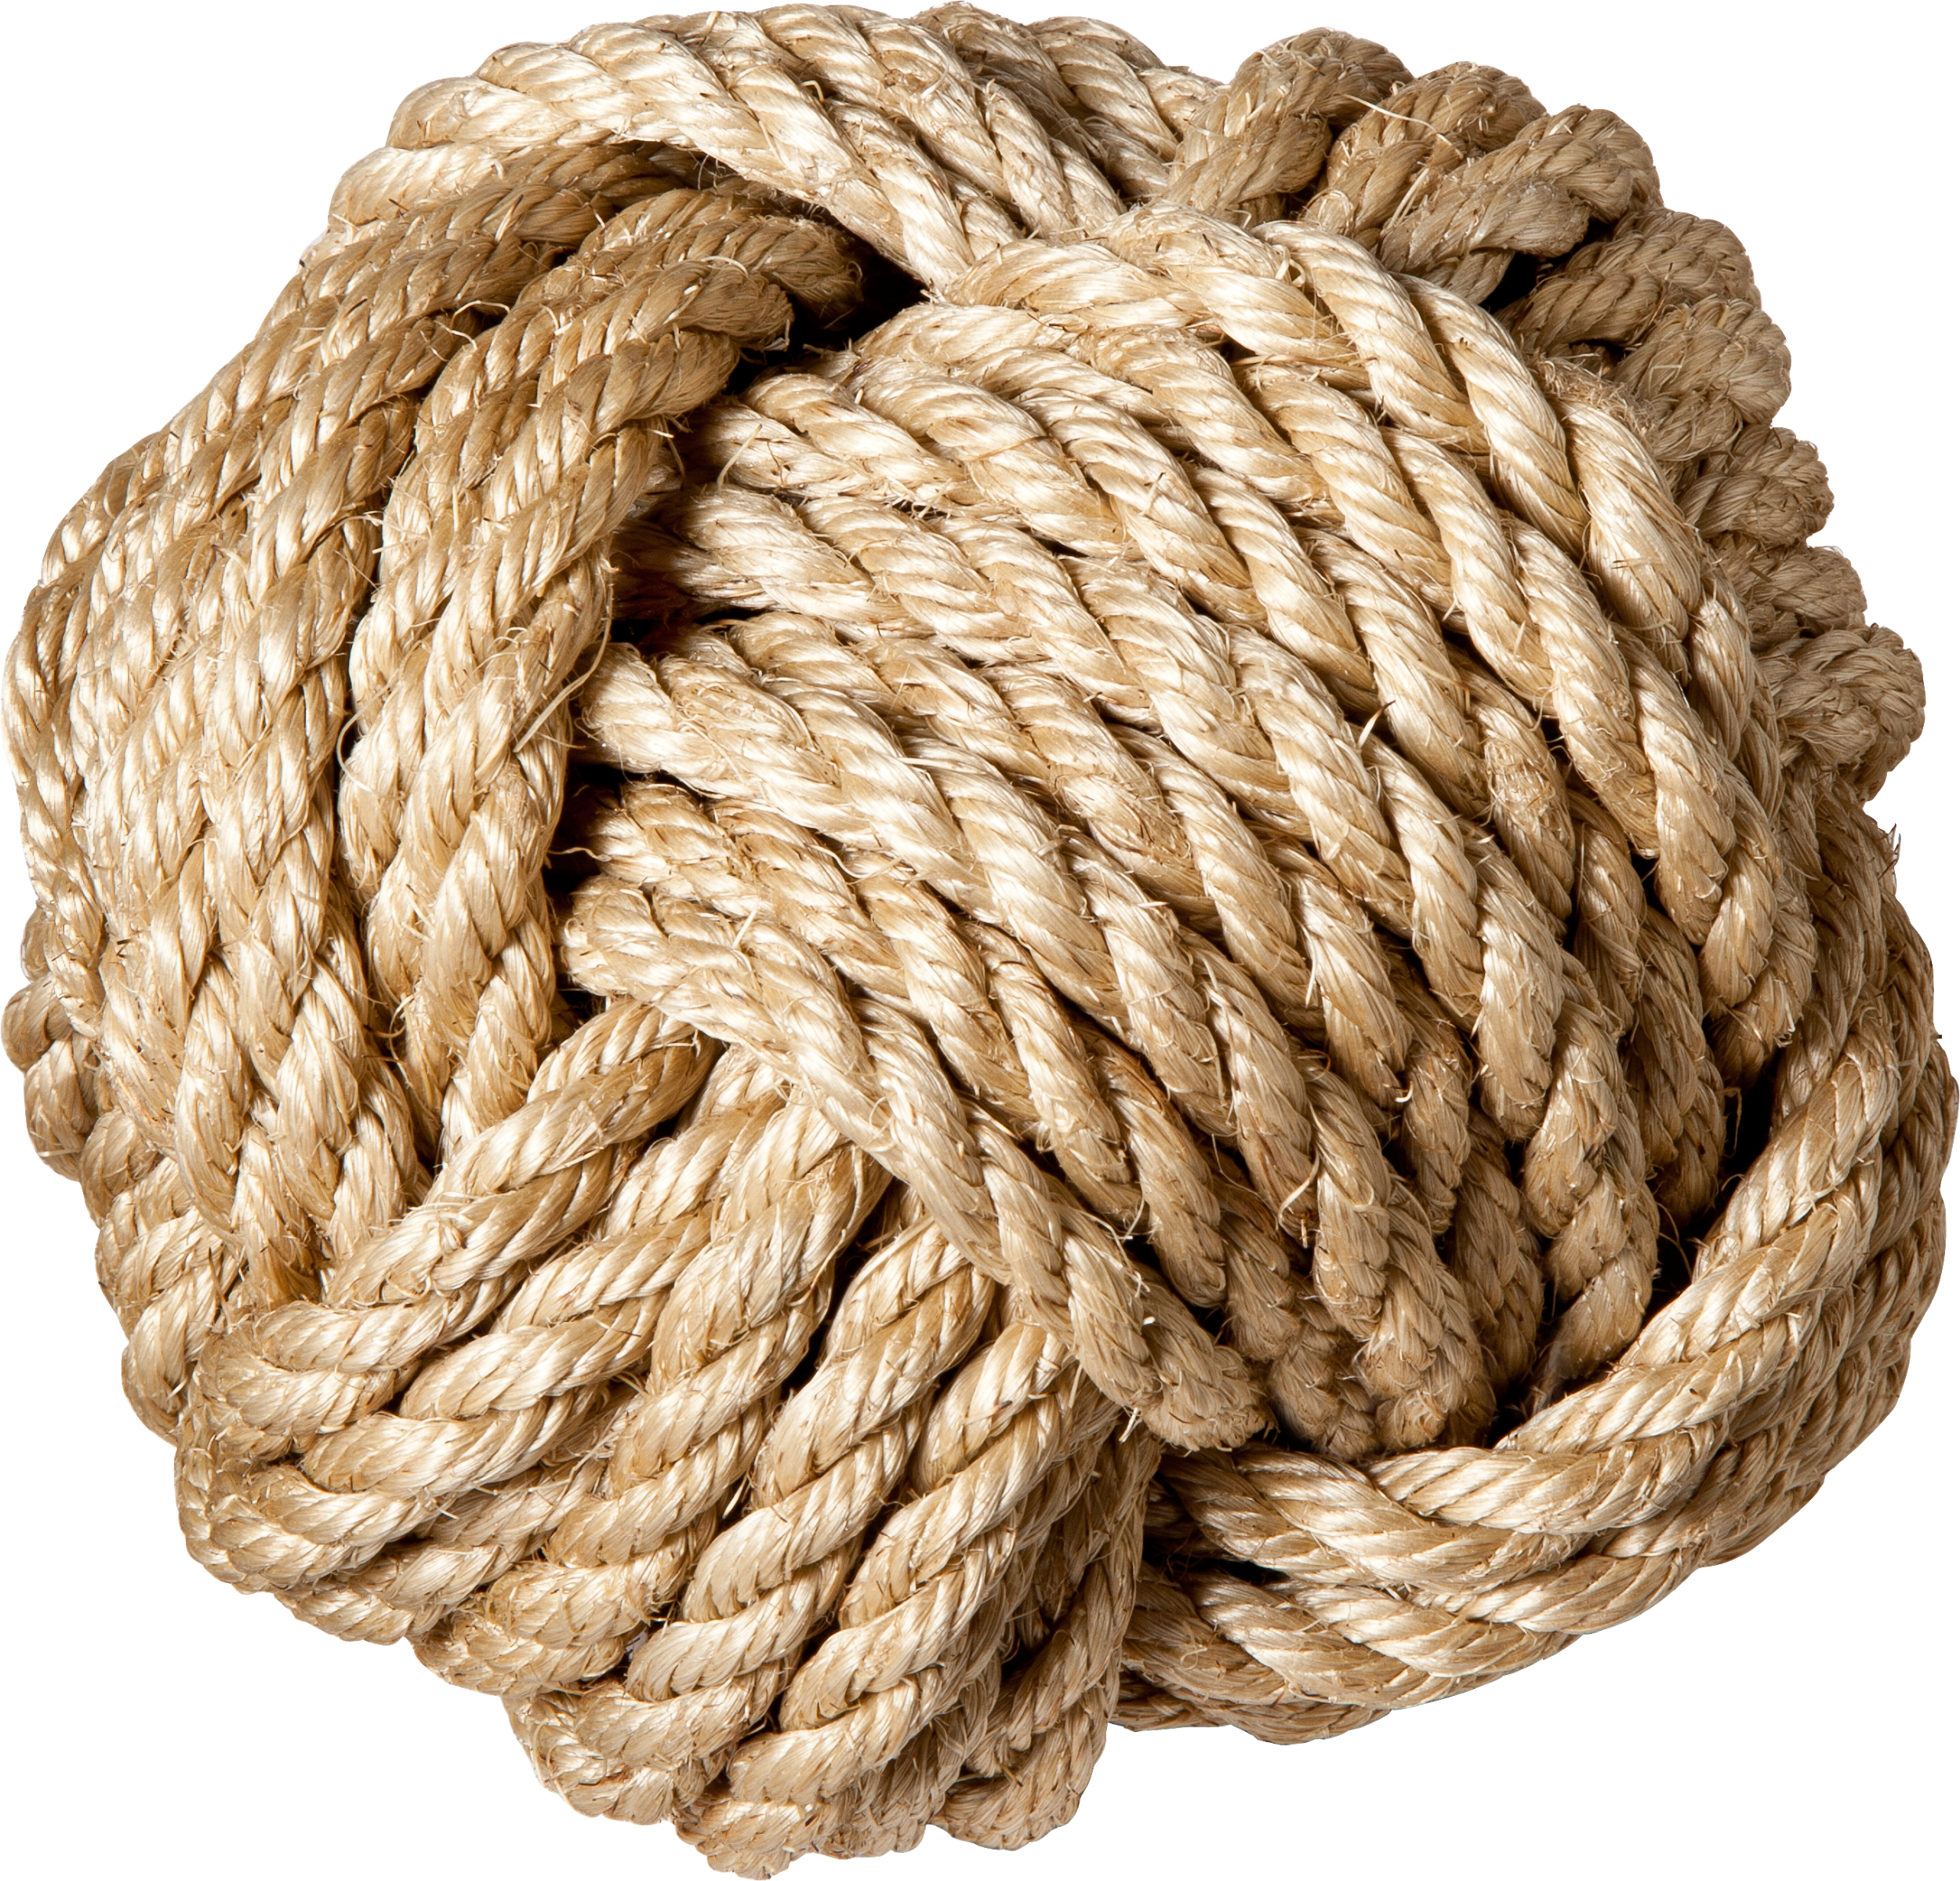
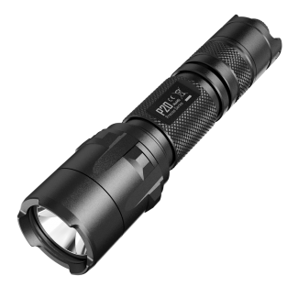
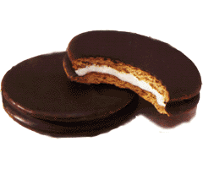

Recursive example
weight:
6
3
4
2
10 lb. capacity
value:
30
14
16
9
How much value in 10 lbs?
4 lbs?
8 lbs?
7 lbs?
6 lbs?
0?
2?
2?
6?
1?
5?
4?
1?
5?
0?
4?
4?
3?
3?
2?

Slide 19
Recursive example
weight:
6
3
4
2
10 lb. capacity
value:
30
14
16
9
How much value in 10 lbs?
4 lbs?
8 lbs?
7 lbs?
6 lbs?
0?
2?
2?
6?
1?
5?
4?
1?
5?
0?
4?
4?
3?
3?
2?

Slide 20
Bottom-up example
weight:
6
3
4
2
value:
30
14
16
9
Size:
0
1
2
3
4
5
6
7
8
9
10
Max val:
0
0
9
14
18
23
30
32
39
44
48
Notes:
Compute values to take max of on board

